Slide 1



Summer Industrial Internship
SAIMA CORPORATION
ABHINAV AZAD |ED17B001
Tsujido,
Japan

Slide 2
Content:
Objective
Material Study
Market Research
Basics of Torque Analyzer
Experiment Data & Plots
Results, Tends & Conclusion

Slide 3
Objectives:
To understand Hard Plastic Market.
To check workability of the New Special Non-sert for Bakelite and Epoxy.
Investigate and find suitable conditions(Drill Hole & Load) for the Special Non-sert screw.

Slide 4
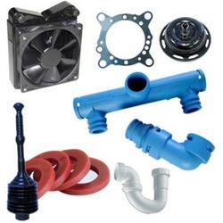
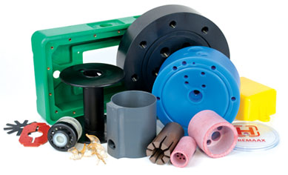

Hard Plastics ~ Thermoset Plastics
A Thermosetting plastic is a polymer that irreversibly becomes rigid when heated.
Brittle, which makes machining tough on it.
Highly Resistive towards Heat and Electricity
Hence, well-suited to the production of permanent components and large, solid shapes.
Major Focus on:
BAKELITE
EPOXY Resin

Slide 5
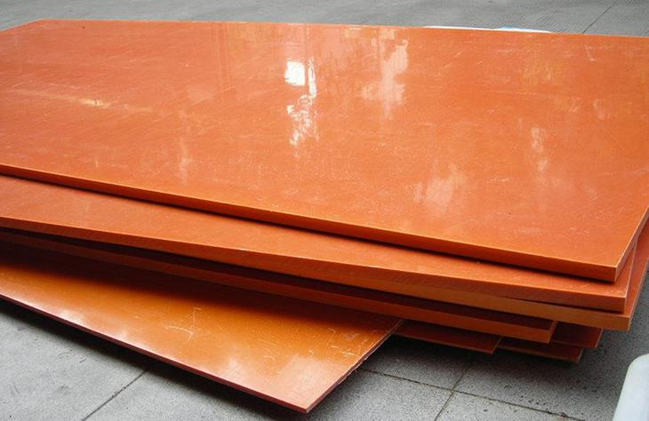
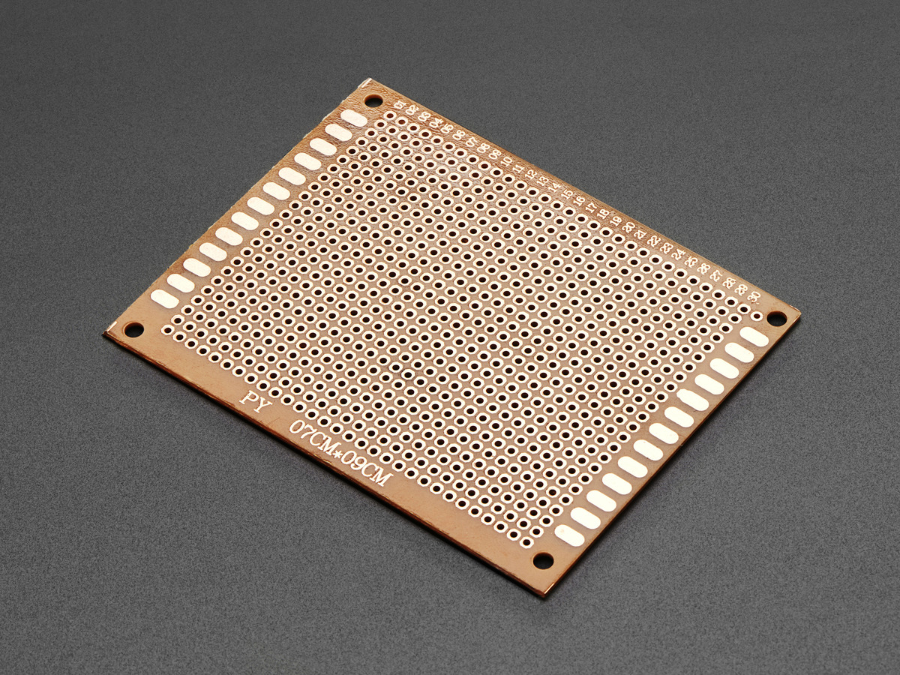
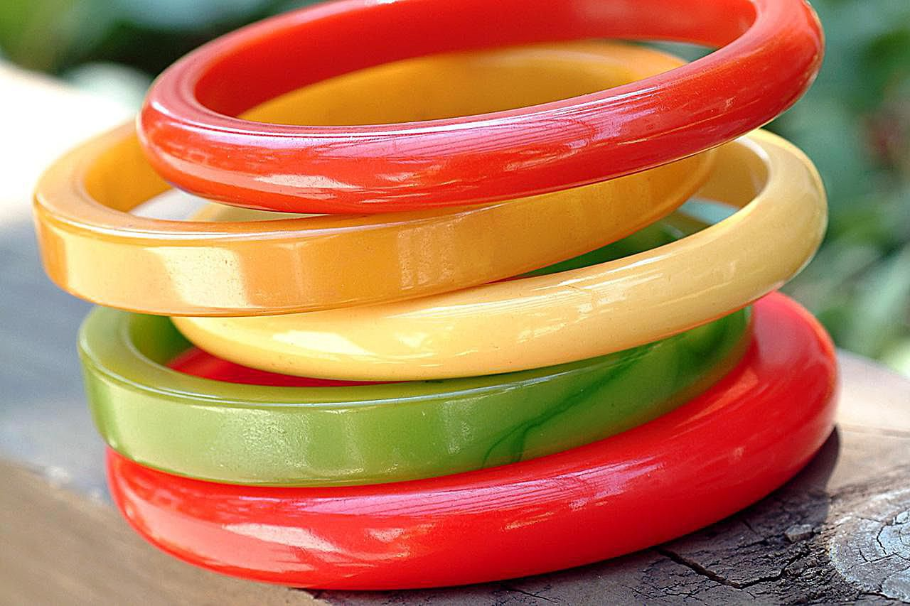
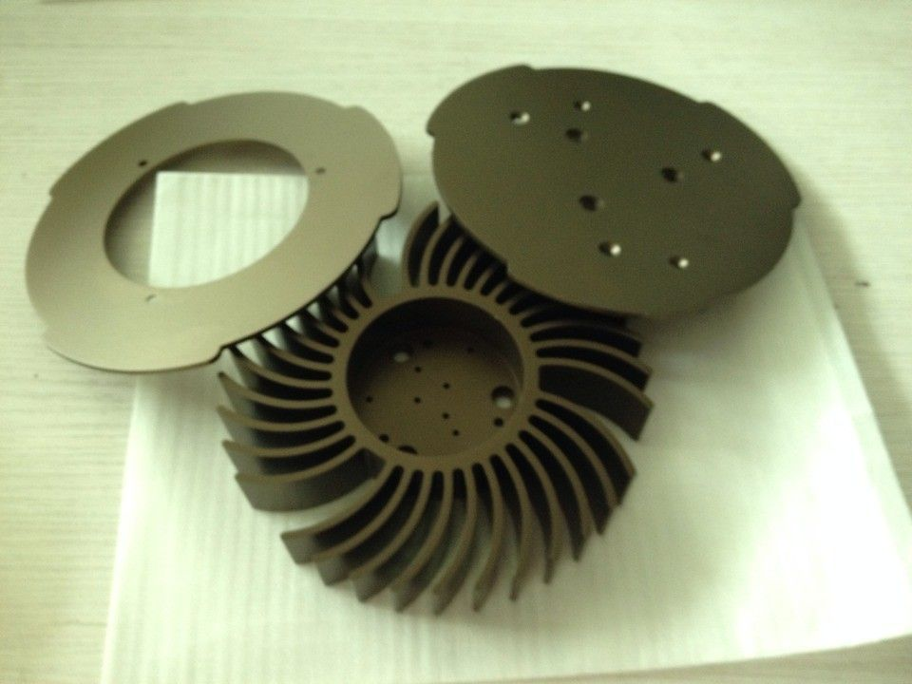

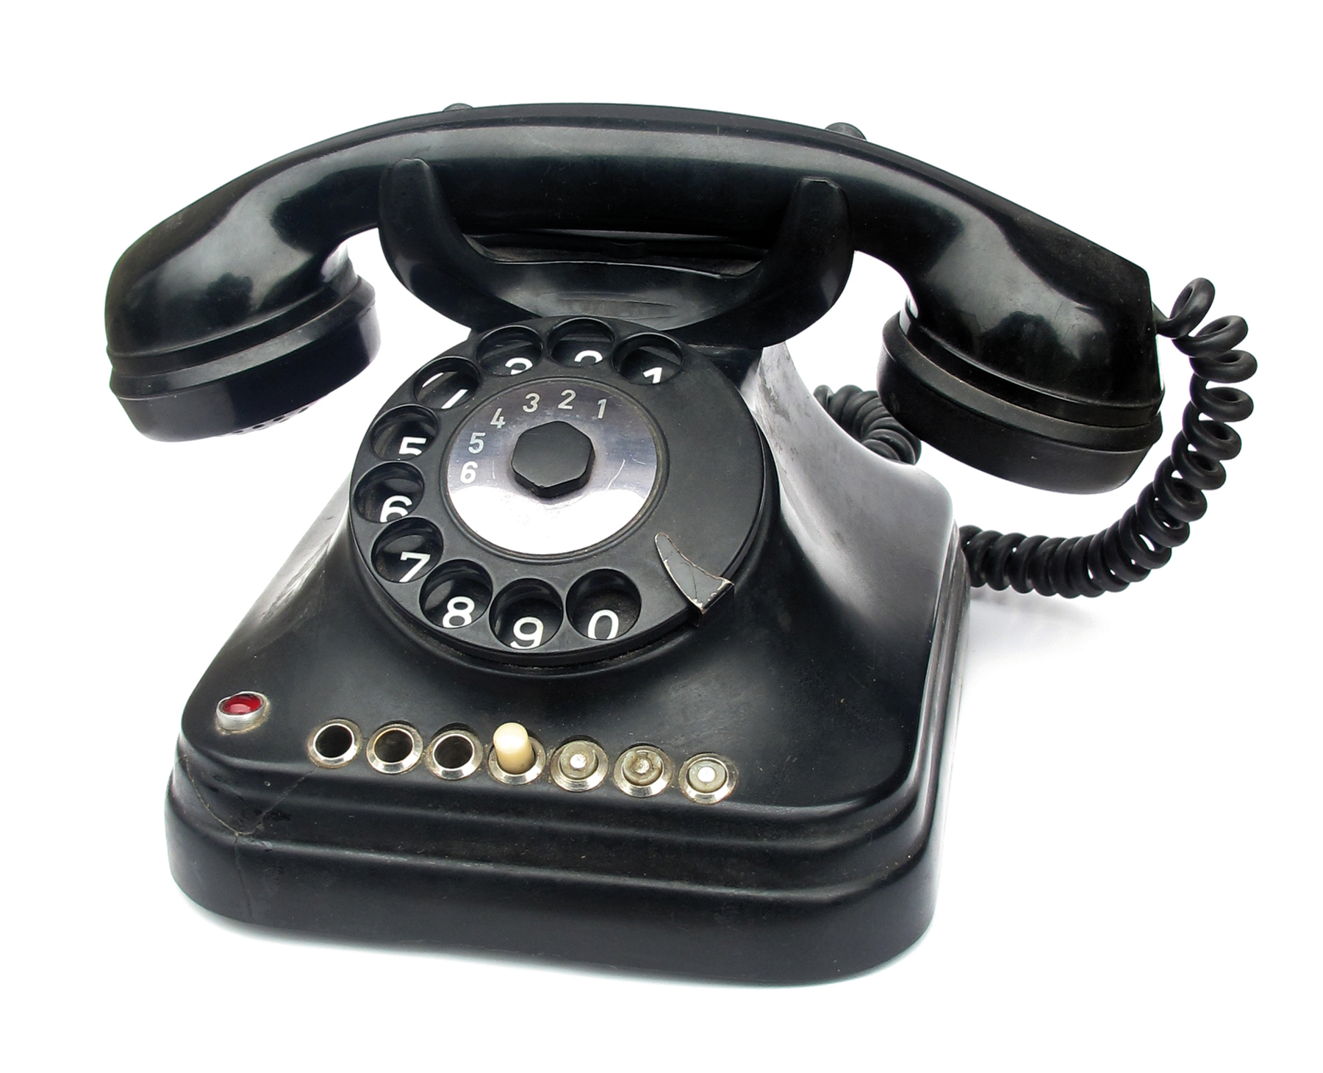
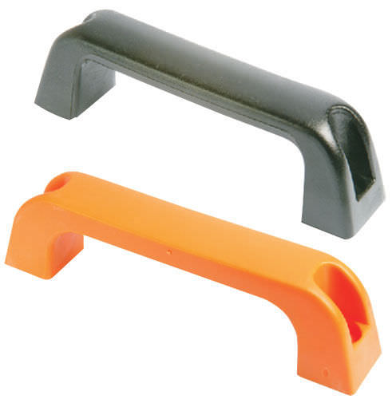
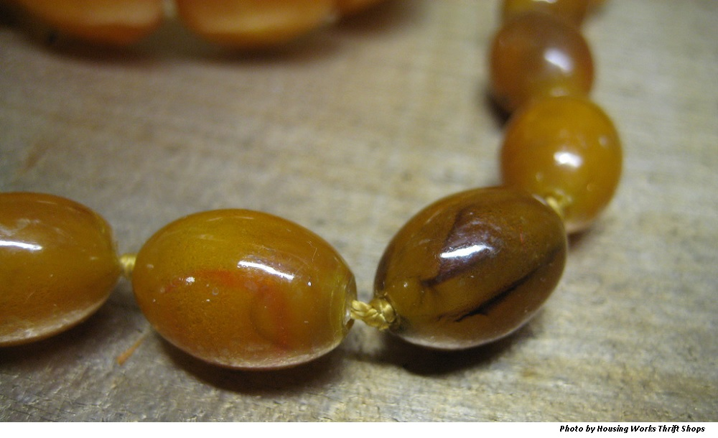
Bakelite- Market Research
BAKLITE transformed the lives of people as it was discovered:
Replaced skins, bone, ivory, wood, metals, plant fibers, and animal hair.
It is Heat and Chemical resistant, so used extensive in Industries as insulator and resistors.
Jewelry, clocks, radios, telephones, kitchenware, tableware, playing tools.

Slide 6
Major types :
Paper Bakelite
Fabric Bakelite
Excellent mechanical strength, High impact strength
USES: Where mechanical strength is more important than electric insulation- wear resistance, resilience.
Potential Market: Electric Boards, Electronic Industry, Fashion industry.
Disadvantages: Water Absorption over long period usage.
Manufacturers/dealers: Shreelam Insukation(Mumbai), INSULECT, ZTELEC Group, SUMITOMO BAKELITE, Krishna Hylam
High impact strength, Good Machinability, Non-abrasive, Chemically resistant.
USES: Electrical Isolating Bolt Sleeves, Washers and Gaskets, Wear plates, Gears, roller, spacers
Potential Market: Textile Shuttles, pickers, Gears, Pulley, Bearing & wearing Plate.
Disadvantages: Water Absorption over long period usage,
Manufacturers/dealers: SUMITOMO BAKELITE, INSULECT, Krishna Hylam

Slide 7
Properties Comparison:
Paper Bakelite
Fabric Bakelite
Parameters | Paper based | Fabric based
Density | 1.3-1.4 g/cc | 1.4- 1.5g/cc
Composition | Cellulose pulp + phenolic resin | Woven Cotton Fabric+phenolic resin
Colour | Black/Orange | Brown/ Natural
Price rate | 57 yuan/kg | 19 yuan/kg.
Heat Resistance | 140 C | 125 C
Flexural Strength | 130 MPA | 110MPA
Water Absorption (D-24/23, thickness 1.6mm) | 265 mg | 220 mg

Slide 8


Bakelite- Market Research
automotive industry in the Asia-Pacific region.
North America and European in aerospace and power generation industries

Slide 9
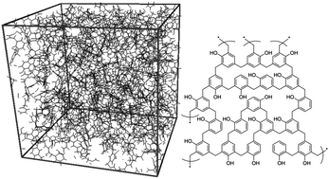
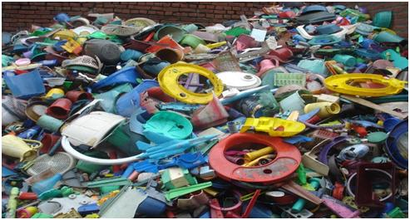
Bakelite- Market Research
Bakelite is a 3-D cross-linked network structured thermosetting polymer which is difficult to recycle after use.
Bakelite is proved to be hazardous to the atmosphere during production processes such as compilation, manufacturing, and dumping.
These factors are expected to hinder the market growth over the foreseeable future.

Slide 10
It is seen that Bakelite resin has been replaced by epoxy resin in recent times with more reinforcement features embedded in them.
Compared tensile strength matrices, epoxy has higher value than Bakelite too.

Slide 11
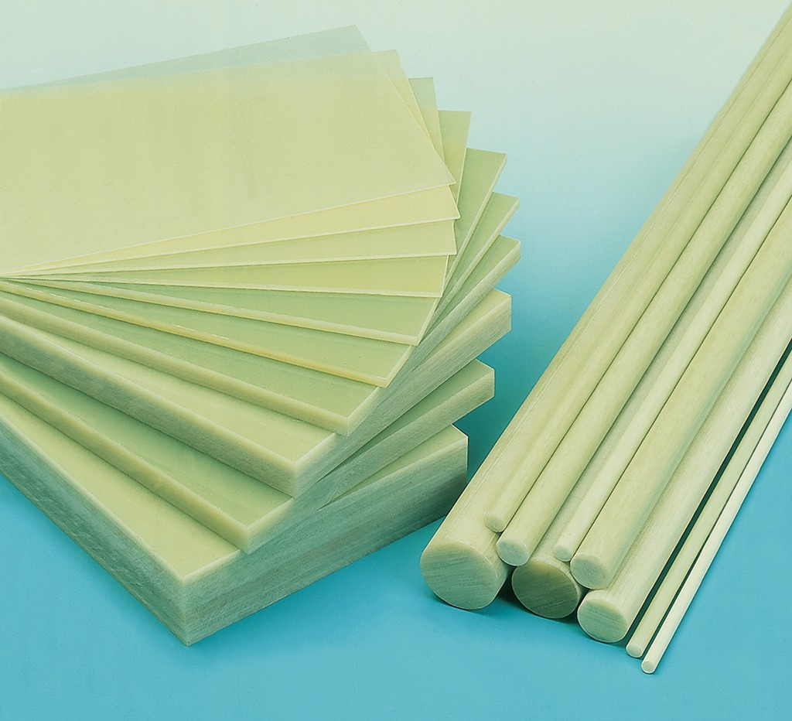
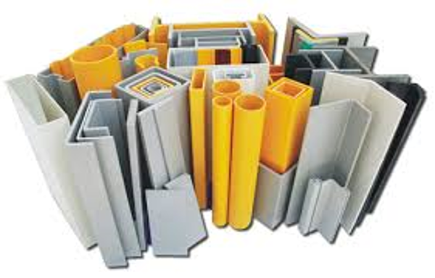
EPOXY- Market Research
Low water Absorption, Excels in insulation and heat resistance.
USES: manufacture of spacers, mechanical barriers, Insulation Plate, Permanent long-term installments.
Potential Market: Electronics Industries, Navy, Housing Solutions.
Disadvantages: Poor machinability (causes cracks)
Manufacturers/dealers: Nan Ya Plastic Corporation (Taiwan), Olin (U.S), Kukdo Chemical co limited (Japan),Aditya Birla Chemicals Ltd RISHO, CARBEX, FR4 Materials

Slide 12
Properties ~ EPOXY :
Parameters | EPOXY
Density | 1.8g/cc
Composition | Bonded with glass fiber cloth and epoxy resin
Colour | White, Green
Price rate | 23 and 43 yuan/kg
Heat Resistance | 140-160 C
Flexural Strength | 130 MPA
Water Absorption | 0.10%

Slide 13
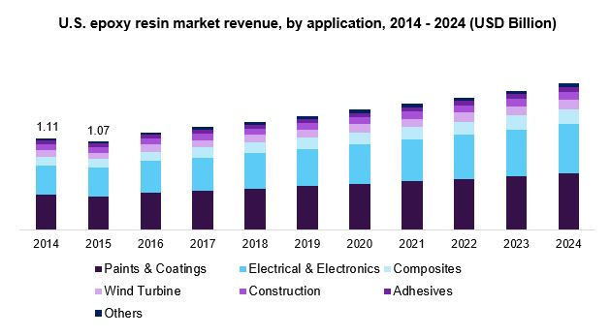
EPOXY- Market Research
North America is another dominant region in the global market, exhibiting an expanding CAGR (Compound Annual Growth Rate).
Increased R&D coupled with technology advancement in the field of modified resins is expected to create new avenues for industrial applications.
The global epoxy resin market size was USD 7.99 billion in 2015.
Notes:
https://www.grandviewresearch.com/industry-analysis/epoxy-resins-market (source)

Slide 14
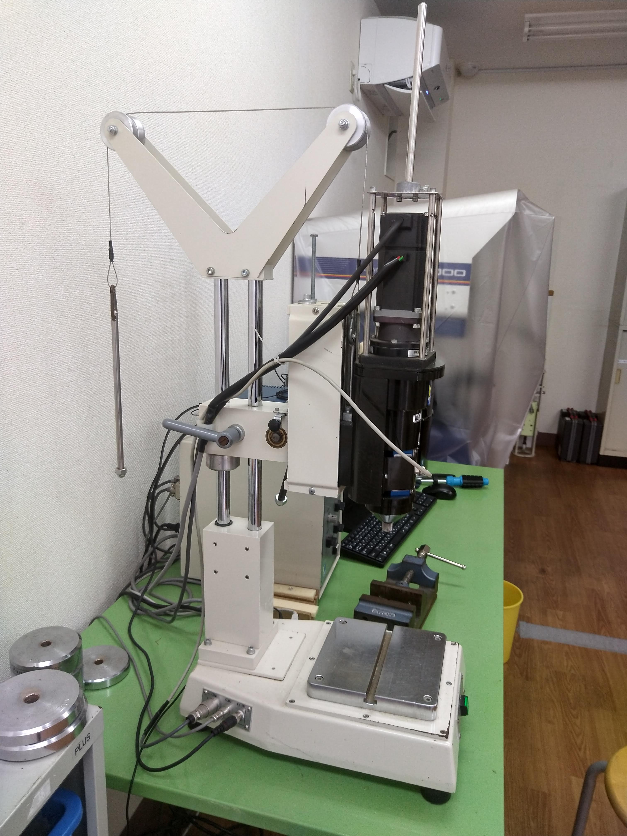
TORQUE ANALYZER
To understand and develop latest fastening technology, Torque analyzer helps arriving at quicker and efficient results.
Measures resistive Torque Vs Time for any given Rotational Speed(PRM).
Parameters used in a Torque Analyzer:
RPM
Fastening Bit
LOAD

Slide 15
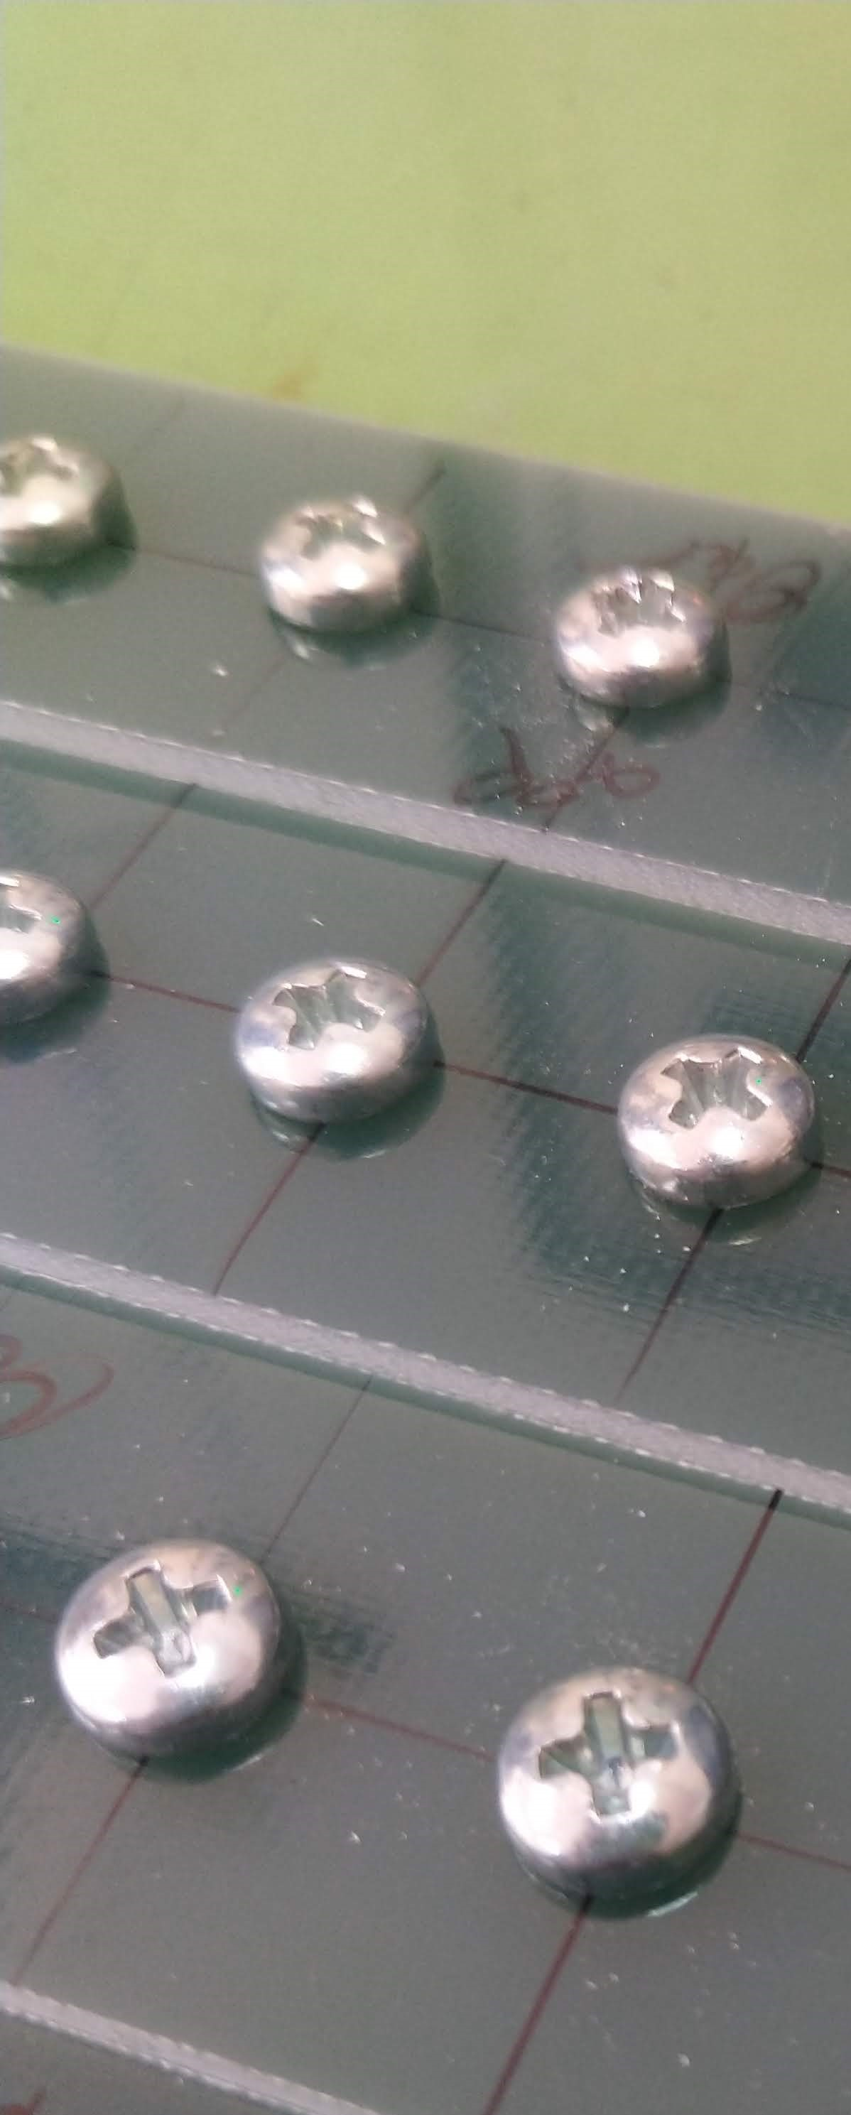
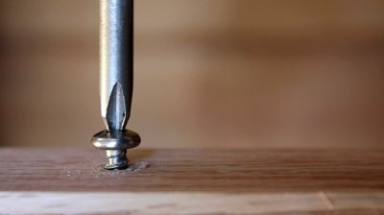
Normal Idling
When a fastening is successful, which means all the parameters compliments well enough for a workable screw tightening, its usually called Normal Idling

Slide 16
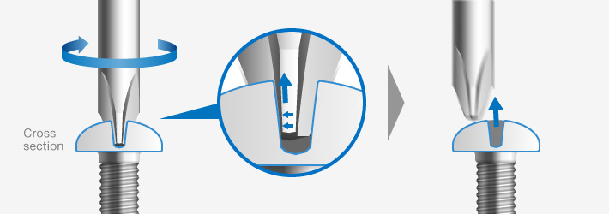
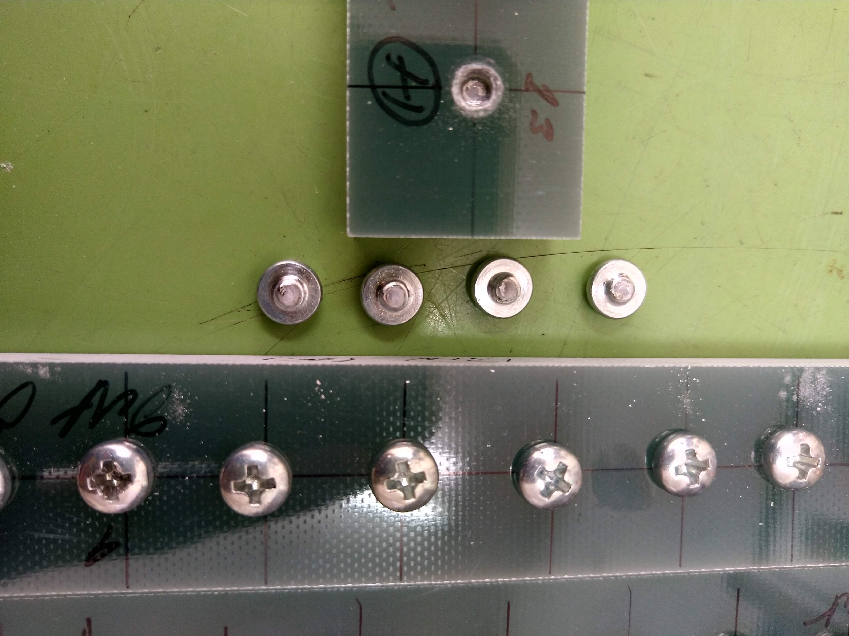
CAM-OUT
Head Break
Unsuccessful Fastening.
The Drill bit comes out of the hole, loosing the connection between with screw.
Successful Fastening.
Screw Top breaks apart from the screw body.

Slide 17
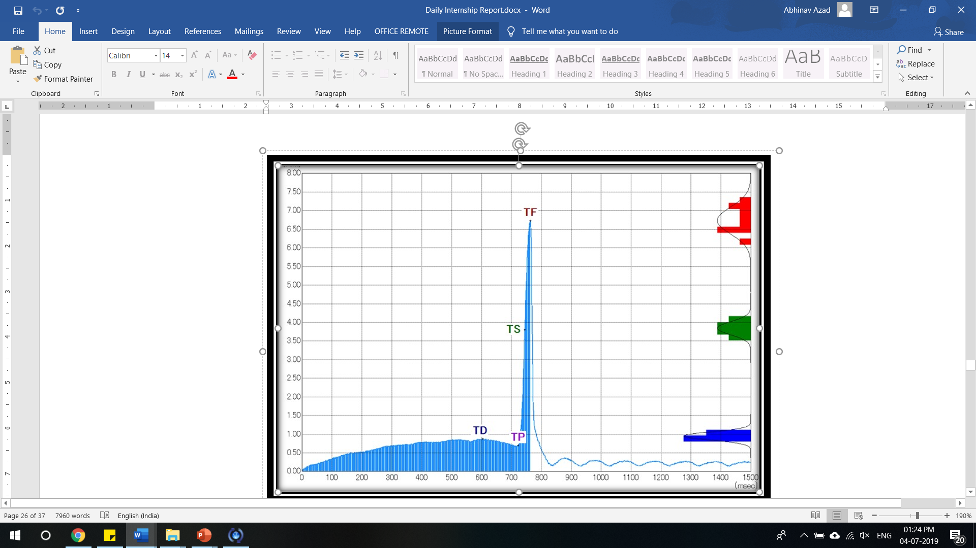
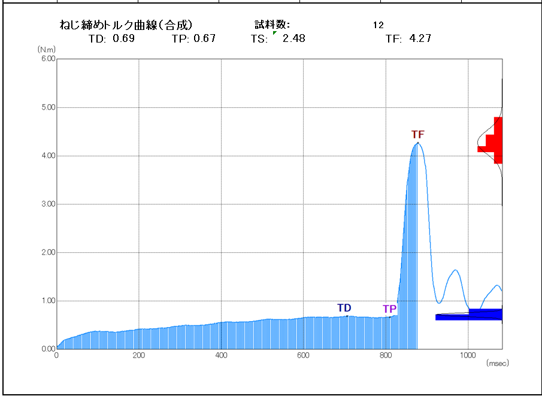
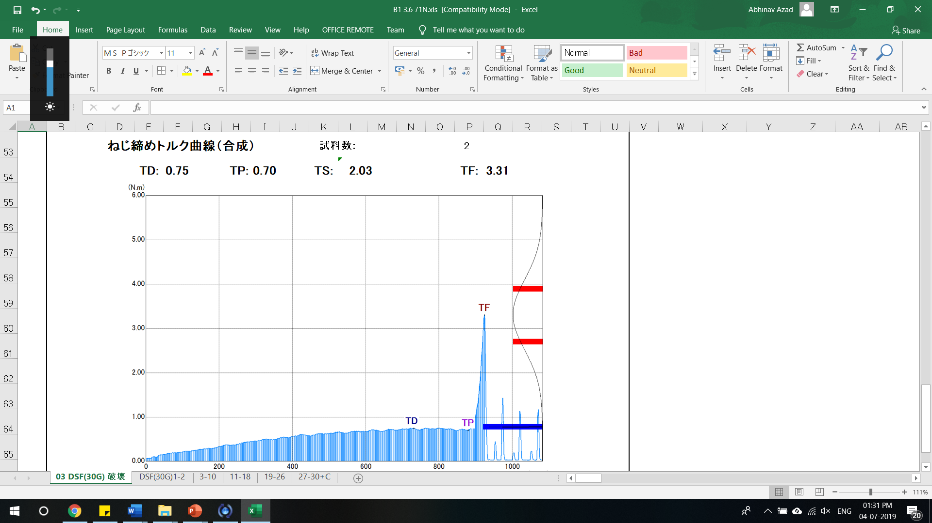
Normal Idling
Head Break
PLOTS Comparison
CAM OUT

Slide 18
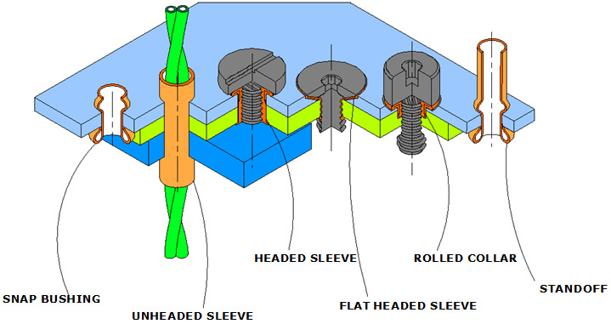
FASTENERS for PLASTICS
Conventional Fasteners which requires Inserts
Dealer: NYLTITE Corporation of America

Slide 19
Do we have a Better way?

Slide 20
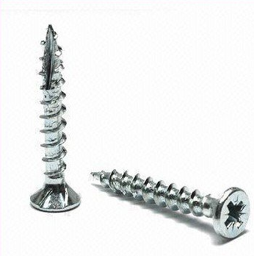
Self-Tapping screws: INSERT NOT NEEDED!
Forms Female Thread part on its own as it screws in the Hole
Cost reduction, No Thread Insert Required
Faster to Install
Robust Application
More Efficient and less Failure
Sophisticated Manufacturing.

Slide 21
Fasteners for Thermoset Plastics
CHALLENGES:
Brittle Material
Much Harder than Thermoplastics
Limited and Selective Market.

Slide 22
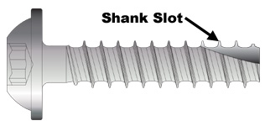
Delta PT-S
Everything same as Delta PT with addition of Shank Slot at the end.
Multi-compound 30° flank angle and root for dynamic safety
Increased vibrational safety by improved pitch
Cutting edge for lower installation torque

Slide 23
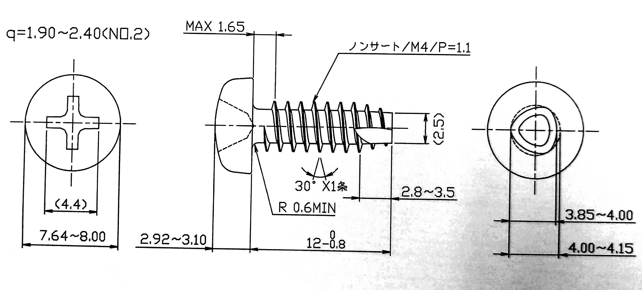
SAIMA’s Special NONSERT
NONSERT: A brand of SAIMA that features Self-Tapping screws.
Special NONSERT: NONSERT screws specially meant for Thermoset plastics
Thread Angle: 30 Degrees Pitch : 1.1mm Thread Profile: Triangular
Cutting EDGE (Slank Shot)

Slide 24
The Design:
Reduces stress due to low flank angle.
Insert elimination possible.
Offers Repeatability in thermosets.
The special Triangular thread profile such that the material can exert resistance only at the three edges unlike in the circular one, where resistance is at all the points of the thread line.

Slide 25
Testifying SAIMA’s Special Non-sert for Thermoset Plastics
Results and Analysis of Torque Analyzer Outputs upon testing the screws on different loads and implications.

Slide 26
Bakelite Material

Slide 27
3.7 MM BIT Material: Brown Paper Bakelite (NO CAM OUTS)
Load | 181 N | 151 N | 131 N | 111 N | 91N
TD | 0.712 | 0.588 | 0.656 | 0.687 | 0.588
TS | 2.48 | 2.06 | 2.28 | 2.51 | 2.06
TF | 4.27 | 3.562 | 3.919 | 4.353 | 3.562
F/D | 6.011 | 6.05 | 5.97 | 6.336 | 6.054
3.6 MM BIT Material: Brown Paper Bakelite (5/12 CAM OUTS)
Load | 181 N | 151 N | 131 N | 111 N | 91N
TD | 0.682 | 0.734 | 0.721 | 0.759 | 0.728
TS | 2.67 | 2.80 | 2.45 | 2.77 | 3.26
TF | 4.7 | 4.894 | 4.194 | 4.807 | 5.804
F/D | 6.962 | 6.67 | 5.82 | 6.32 | 8.205
3.5 MM BIT Material: Brown Paper Bakelite (5/12 CAM OUTS)
Load | 181 N | 151 N | 131 N | 111 N | 91N
TD | 0.710 | 0.739 | 0.728 | 0.731 | 0.665
TS | 2.78 | 2.4 | 2.52 | 2.43 | 2.34
TF | 4.787 | 4.084 | 4.331 | 4.141 | 4.038
F/D | 6.92 | 5.52 | 5.95 | 5.66 | 6.126

Slide 28
CAM OUT

Slide 29
Drill Bit: 3.5/3.6/3.7 mm Load: 181/151/131/111/91 Newtons
RESULTS
As Load Increases all the Plots appears o shift UPWARDS, until failure(CAM OUT) is observed.
Cam out was observed for loads lesser than 111 N. We can also notice an Unusual Bump in the plots.
For 91 N some of the testing were successful but others were failing (CAM-OUT).
And, for 71 N all the test samples failed, except 3.7mm samples(1/12 failed), which also shows that for a larger Hole, Failure and Driving Torque decreases.
No Head Breaking observed as now.
With cumulative Observation 131N Load working most CONSISTENT and hence, reliable which is used in further testing.

Slide 30
Load: 131 Newtons | Drill Bit: 3.6 mm | Nos: 36 holes
Material | TD |  |  | TS | TF |  |  | F/D
 | MIN | AVG | MAX |  | MIN | AVG | MAX | MIN | AVG | MAX
Brown Paper Bakelite | 0.65 | 0.721 | 0.81 | 2.45 | 3.96 | 4.12 | 4.32 | 5.11 | 5.836 | 6.55
Black Paper Bakelite | 0.61 | 0.731 | 0.89 | 2.58 | 4.11 | 4.45 | 4.87 | 5.10 | 6.128 | 7.41
Fabric Bakelite | 0.81 | 0.941 | 1.17 | 2.88 | 4.41 | 4.85 | 5.3 | 4.1 | 5.185 | 6.02

Slide 31
Load: 131 Newtons | Drill Bit: 3.7 mm | Nos: 24 holes
Material | TD |  |  | TS | TF |  |  | F/D
 | MIN | AVG | MAX | 2.19 | MIN | AVG | MAX | MIN | AVG | MAX
Brown Paper Bakelite | 0.58 | 0.654 | 0.72 |  | 3.57 | 3.705 | 3.79 | 5.21 | 5.7 | 6.47
Black Paper Bakelite | 0.60 | 0.704 | 0.77 | 2.34 | 3.58 | 4.00 | 4.41 | 4.90 | 5.708 | 6.50
Fabric Bakelite | 0.73 | 0.846 | 0.97 | 2.23 | 3.36 | 3.641 | 3.92 | 3.56 | 4.331 | 5.05

Slide 33
Comparing the previous two Samplings
Material |  | TD |  |  | TS | TF |  |  | F/D
 |  | MIN | AVG | MAX |  | MIN | AVG | MAX | MIN | AVG | MAX
Brown Paper Bakelite | 3.6mm | 0.65 | 0.72 | 0.81 | 2.45 | 3.96 | 4.12 | 4.32 | 5.11 | 5.836 | 6.55
 | 3.7mm | 0.58 | 0.654 | 0.72 | 2.19 | 3.57 | 3.705 | 3.79 | 5.21 | 5.7 | 6.47
Black Paper Bakelite | 3.6mm | 0.61 | 0.731 | 0.89 | 2.58 | 4.11 | 4.45 | 4.87 | 5.10 | 6.128 | 7.41
 | 3.7mm | 0.60 | 0.704 | 0.77 | 2.34 | 3.58 | 4.00 | 4.41 | 4.90 | 5.708 | 6.50
Brown Fabric Bakelite | 3.6mm | 0.81 | 0.941 | 1.17 | 2.88 | 4.41 | 4.85 | 5.3 | 4.1 | 5.185 | 6.02
 | 3.7mm | 0.73 | 0.846 | 0.97 | 2.23 | 3.36 | 3.641 | 3.92 | 3.56 | 4.331 | 5.05
MAX
Load: 131 Newtons | Drill Bit: 3.7 mm VS 3.6 mm

Slide 34
RESULTS
Load: 131 Newtons | Drill Bit: 3.7 mm VS 3.6 mm
For Paper Bakelite (Brown/Black), 3.6 drill bit is providing a better result in our testing.
TD is always lower in 3.6mm Holes.
But TF and F/D for 3.7 and 3.6 drill bit are showing considerable difference.
Hence overall, 3.6 drill holes ore optimum for both Paper and Fabric Bakelite with a load of 131 N.
For Fabric Bakelite, the TD Values are highest which means Fabric Bakelite needs a higher driving Torque than other. Also because it is much tougher and stronger due to various reinforcements.

Slide 35
Epoxy Material

Slide 36
Load: 131 Newtons | Drill Bit: 3.7/3.6 mm | Nos: 24 holes
Material/ Specs | TD |  |  | TS | TF |  |  | F/D
 | MIN | AVG | MAX |  | MIN | AVG | MAX | MIN | AVG | MAX
Epoxy3.6mm (9/24 CAM OUTS) | 0.72 | 0.906 | 1.07 | 3.43 | 5.26 | 5.81 | 6.43 | 5.04 | 6.52 | 8.3
Epoxy 3.7mm (3/24 CAMOUTS) | 0.72 | 0.838 | 1.1 | 2.8 | 4.53 | 4.9 | 5.54 | 4.27 | 5.9 | 7.0

Slide 37
RESULTS
Load: 131 Newtons | Drill Bit: 3.7/3.6 mm | Nos: 24 holes
For the 3.6 mm hole fastening, 9/24 cam-out occurred, 4/24 head breaks occurred and overall 13/24 samples failed i.e. more than 50 percent samples were unsuccessful.
Torque vs Time plots for the head break samples were unique and understandable.
For 3.7 mm hole fastening, 3/24 cam-out occurred and other were successful with good performance data.
High Driving Torque (TD) Values are observed

Slide 38
Suggestions / Hypothesis:
3.6 mm drill holes are not suitable for the given Tapping screws in epoxy material.
3.7 mm drill holes can be deployed.
We can have further testing on 3.7 mm drill holes with higher torque to avoid Cam-out instances.

Slide 39
Load: 151/141 Newtons | Drill Bit: 3.7 | Nos: 24 holes
Material/ Load | TD |  |  | TS | TF |  |  | F/D
 | MIN | AVG | MAX |  | MIN | AVG | MAX | MIN | AVG | MAX
Epoxy 3.7, 131 N (3/24 CAMOUTS) | 0.72 | 0.838 | 1.1 | 2.8 | 4.53 | 4.9 | 5.54 | 4.27 | 5.9 | 7.0
Epoxy 3.7, 141 N (NO CAMOUTS) | 0.69 | 0.82 | 0.97 | 2.4 | 3.74 | 4.2 | 4.67 | 4.02 | 5.16 | 6.67
Epoxy 3.7, 151 N | 0.63 | 0.838 | 0.98 | 2.55 | 3.45 | 3.98 | 4.55 | 3.67 | 4.98 | 6.46

Slide 40
Load: 151/141/131 Newtons | Drill Bit: 3.7 | Nos: 24 holes
RESULTS
For a Load of 131 Newtons there were 3 Camouts/ 24 tests. But just by a difference of 10 N load, there was a great improvement in performance and No Camouts were observed.
Although TF values are lowered on increasing Load but TD values are also decreased. And overall, it’s not a problem.
Best optimum results are shown in 141 N Load, which is also an affordable load for manual fastening, because for 141 Newtons there is no risk of Camouts which are there in 131 N load.
On further higher load (151 N) performance turns bad.

Slide 41
In Bakelite(Paper and Fabric) using 3.6mm drill holes with 131 Newton load is most reliable.
Final Conclusions:
In epoxy using 3.7mm drill holes with 141 Newton load is most reliable.

Slide 42
Conclusive Trends:
Driving Torque decreases with increase in hole diameter.
CAM OUTS happening for lesser Loads and smaller Diameter holes. ----------------------------------------------------------------
Failure Torque decreases with increase in hole diameter.
Head Breaks happening at much Higher Loads and smaller Diameter Holes.

Slide 43
SAIMA’s Outreach in India

Slide 44
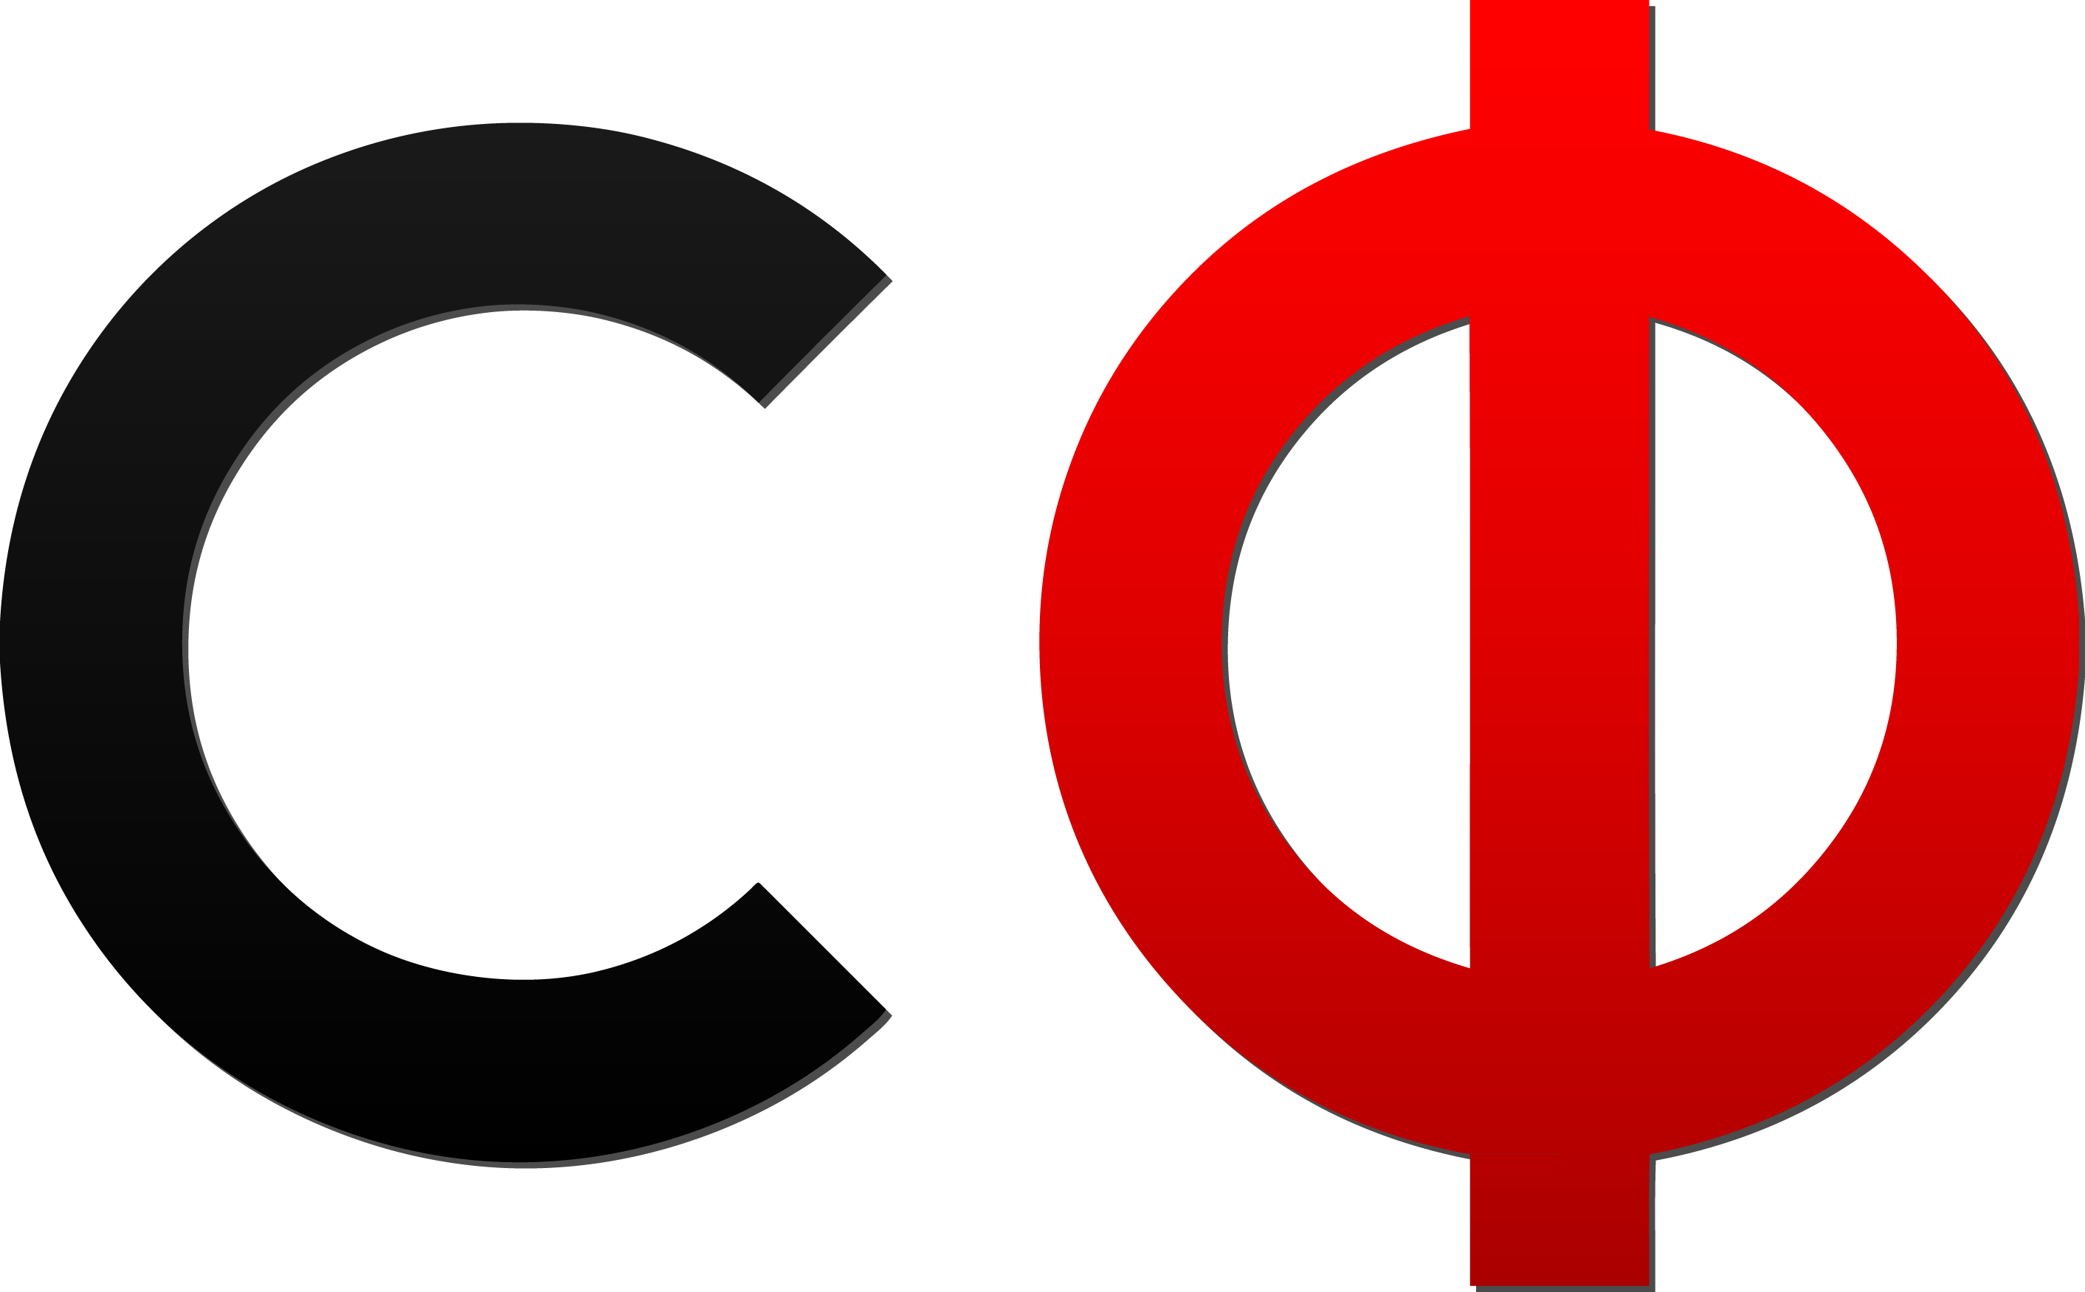
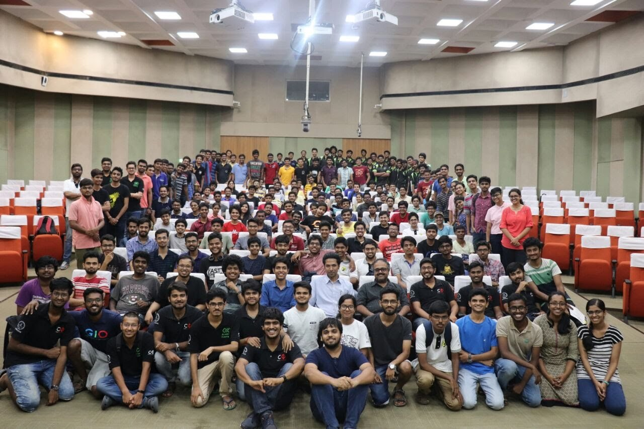
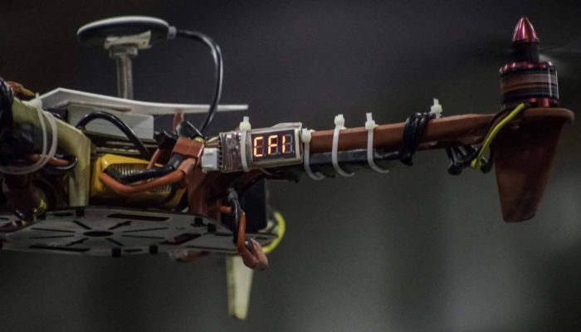
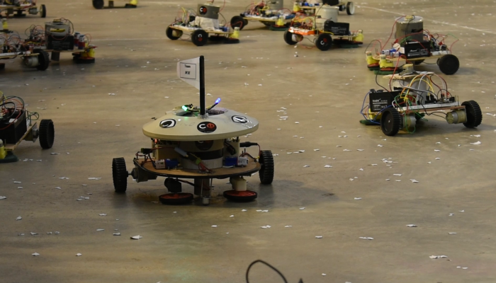
Centre for Innovation, IIT Madras, India
A Large student community in IIT Madras, working towards innovation.

Slide 45
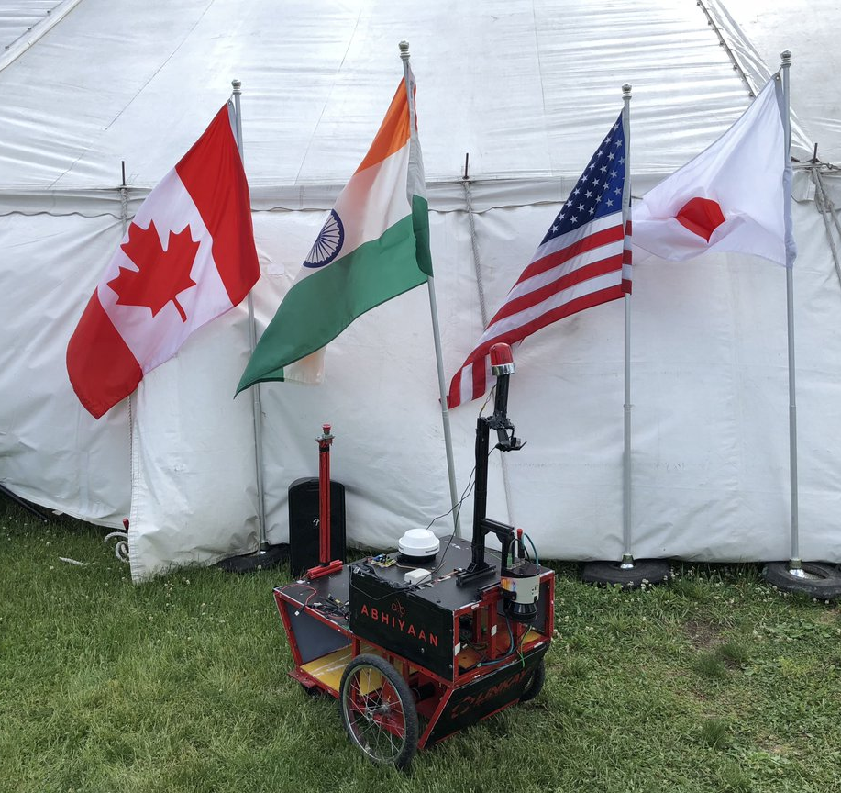
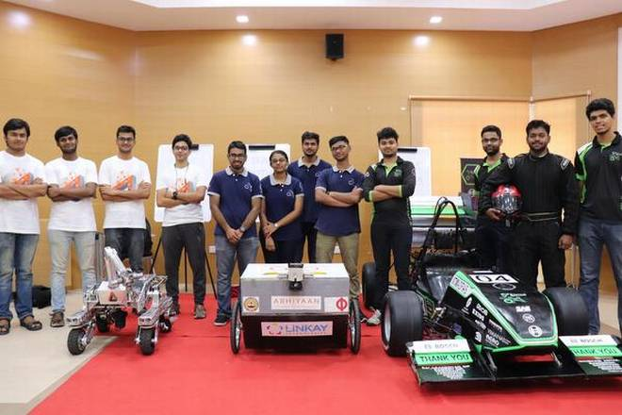
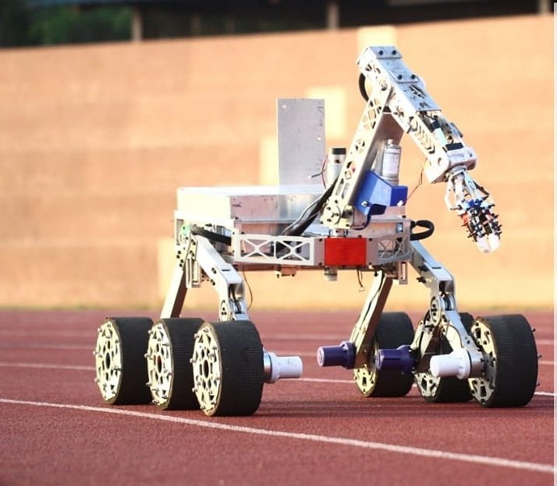
Competition Teams
RAFTAAR: Student formula race Car team
ANVESHAK: Conquest of building best Mars Rover
Notes:
http://cfi.iitm.ac.in/wordpress/

Slide 46
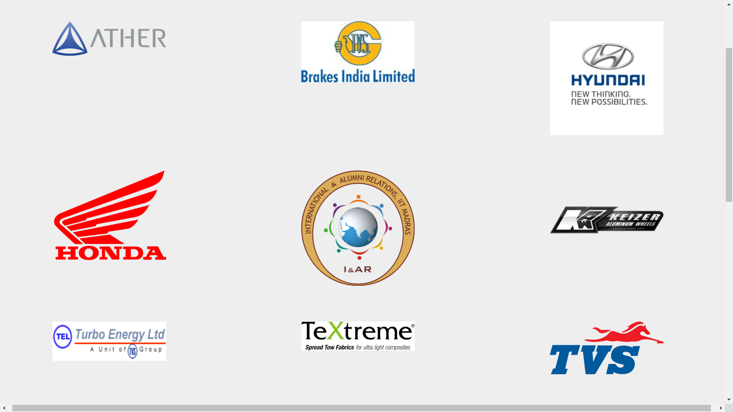

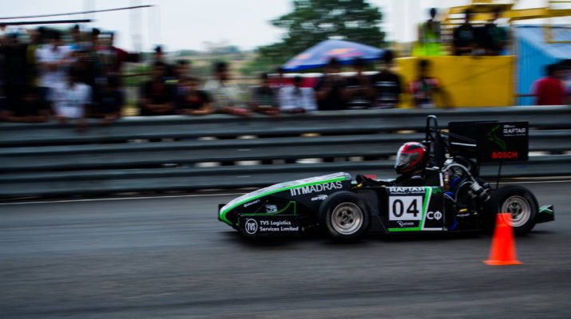
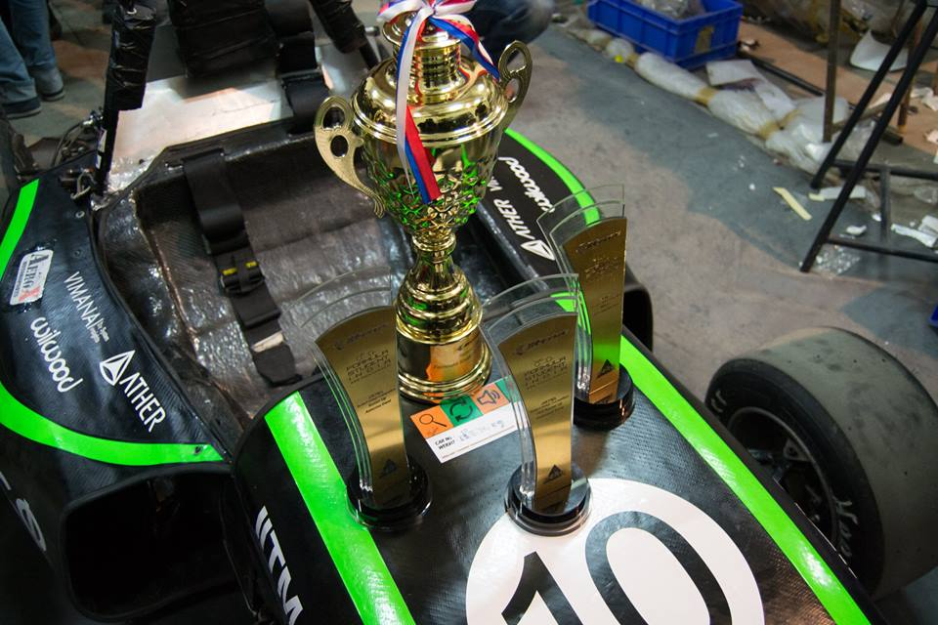
RAFTAAR, Student formula team
Notes:
http://cfi.iitm.ac.in/raftar/views/sponsors.html

Slide 47
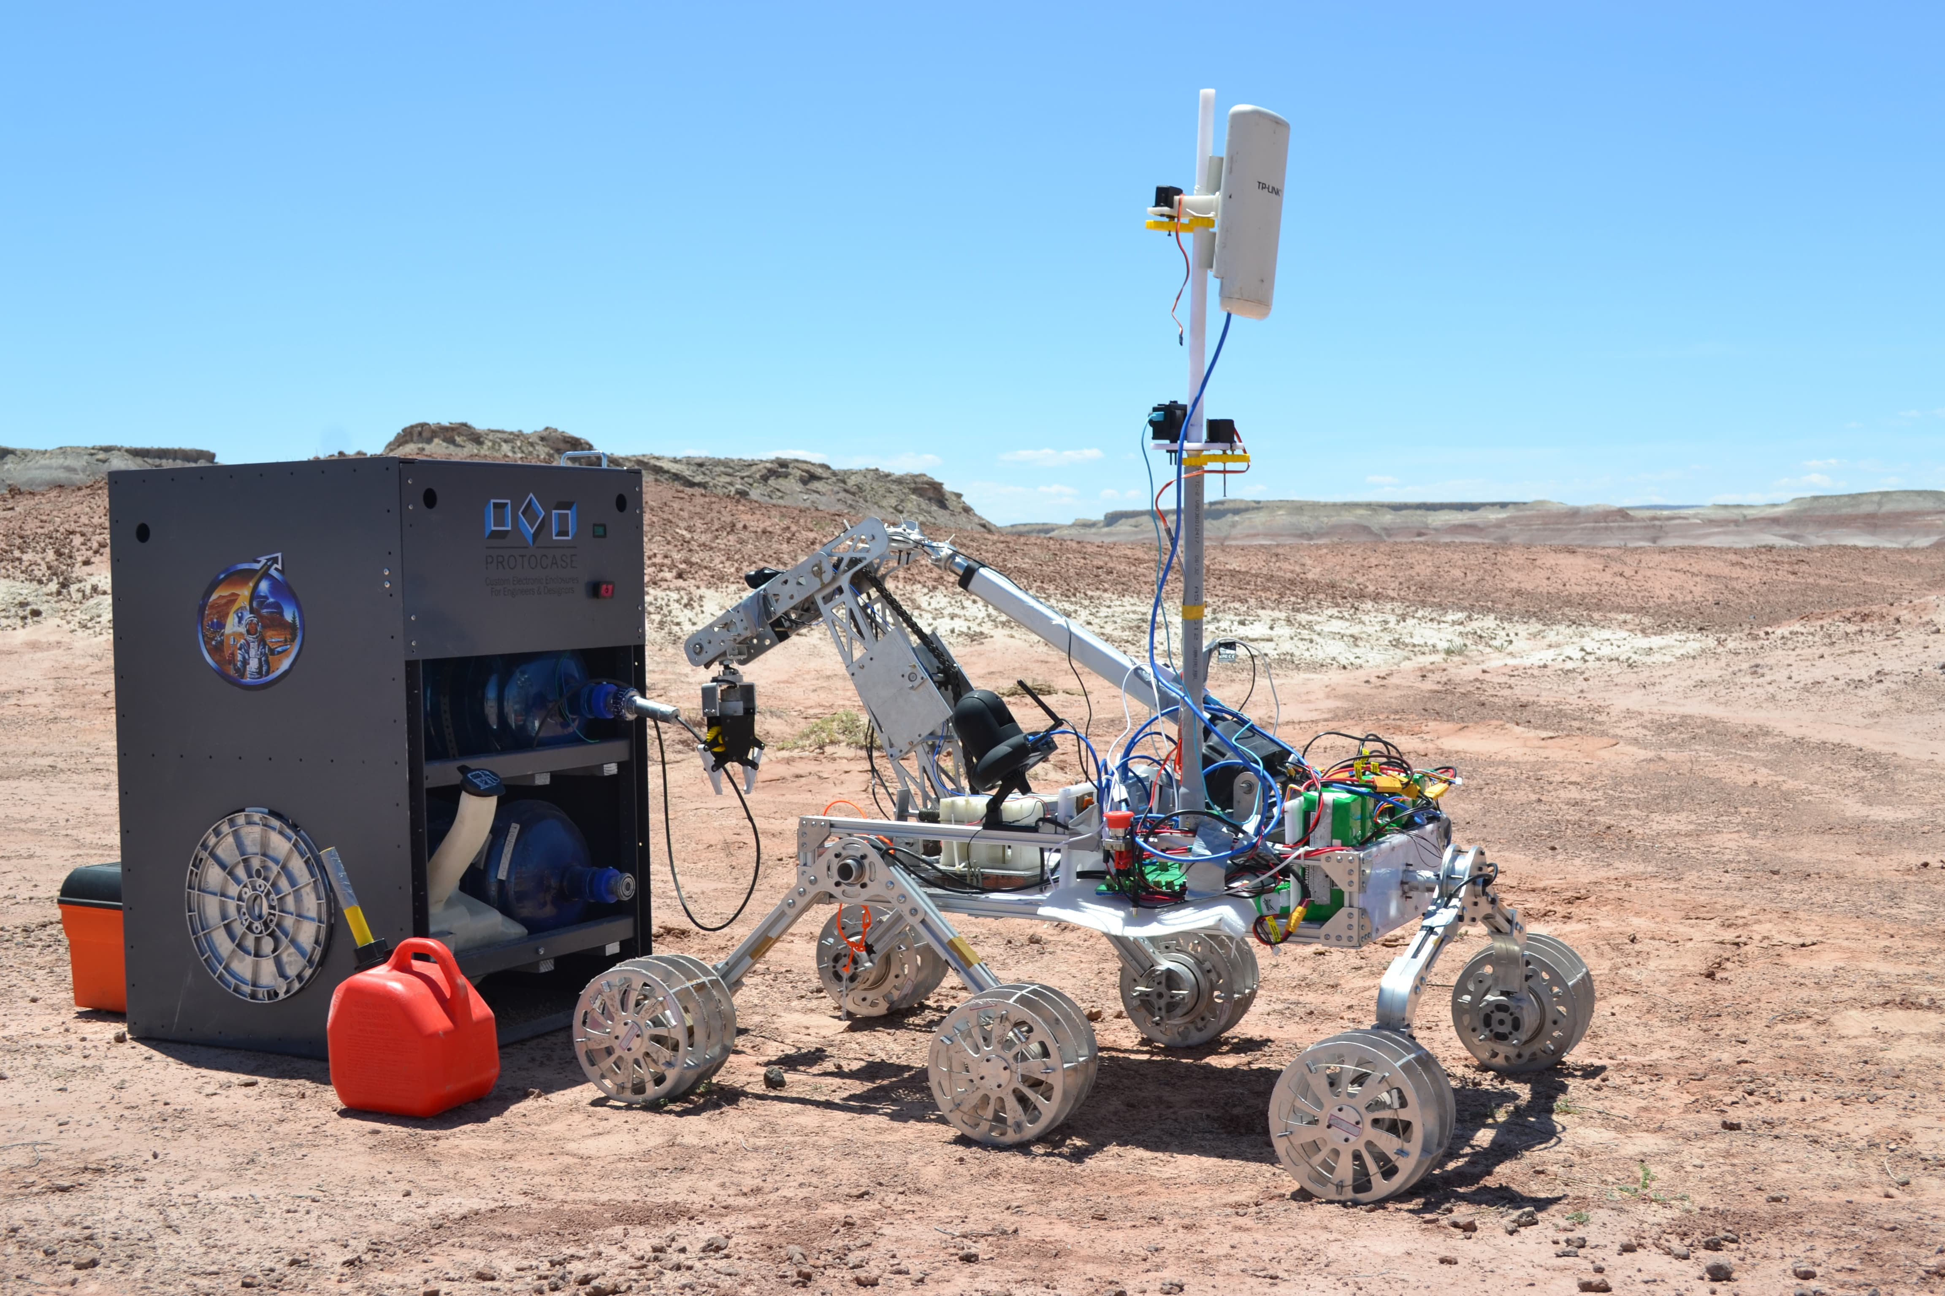
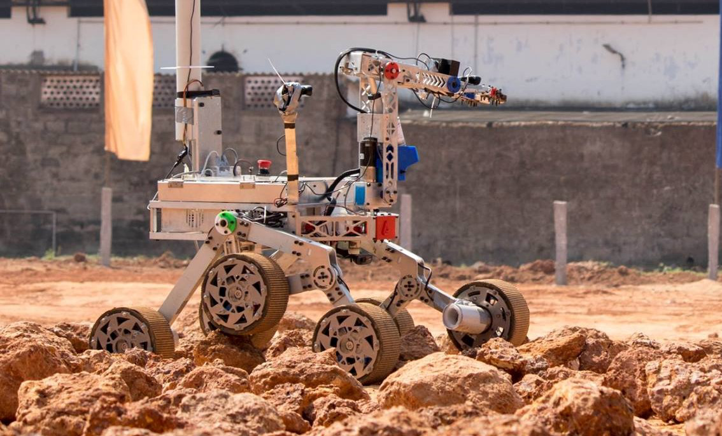
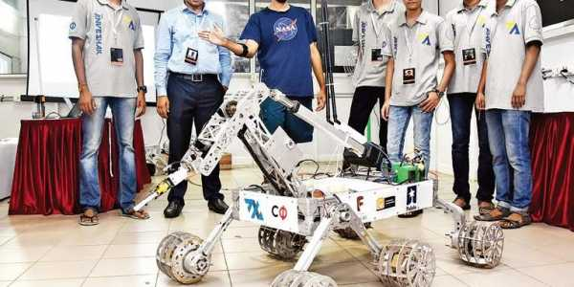
ANVESHAK, manipulator robot team
Competing in International Mars Rover Competitions
Notes:
https://www.youtube.com/watch?v=VEyJ4maBrkg#action=share
http://www.anveshak.team/

Slide 48
Aarigato Gozaimasta ありがとうございました
Thankyou!

